Slide 1
Chef
- Kranthi Kavuri

Slide 2
What is Chef ?
Chef is a powerful automation platform that transforms infrastructure into code. Whether you’re operating in the cloud, on-premises, or in a hybrid environment, Chef automates how infrastructure is configured, deployed, and managed across your network, no matter its size.

Slide 3
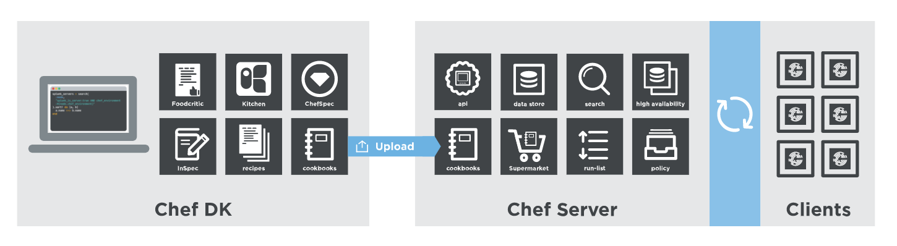
How Chef works
Workstation Chef Server nodes

Slide 4
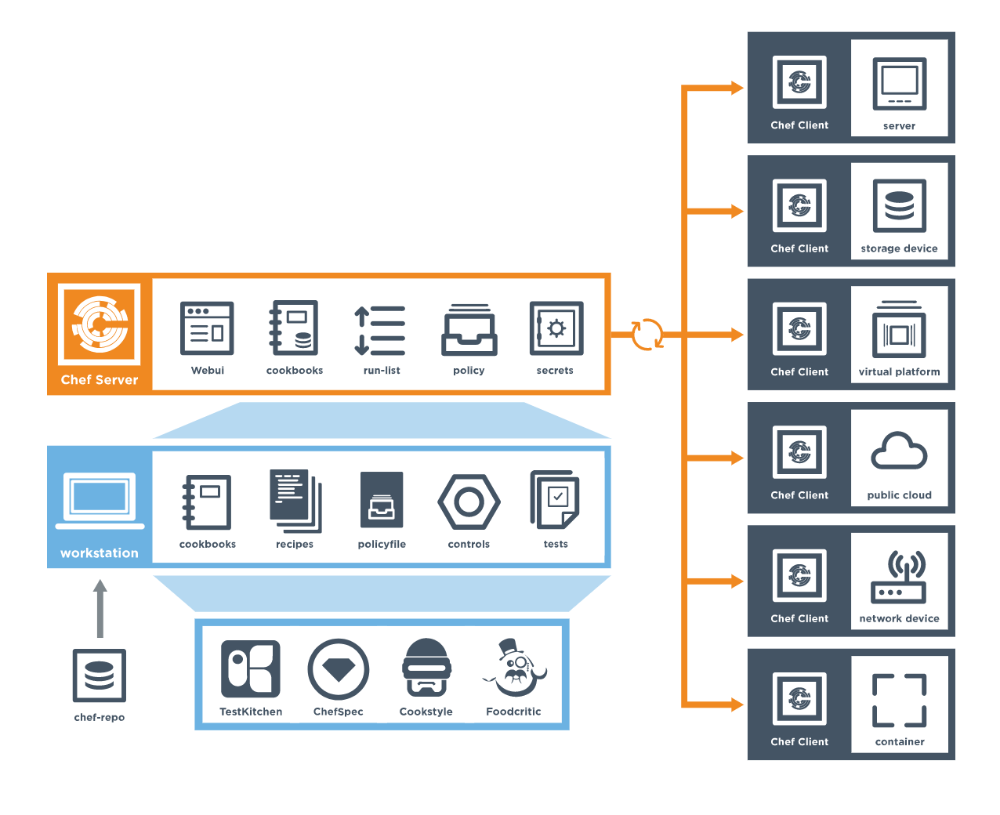
Chef Components

Slide 5
Workstation
A workstation is a computer running the Chef Development Kit (ChefDK) that is used to author cookbooks, interact with the Chef server, and interact with nodes.
The workstation is the location from which most users do most of their work, including:
Developing and testing cookbooks and recipes
Testing Chef code
Keeping the chef-repo synchronized with version source control
Configuring organizational policy, including defining roles and environments, and ensuring that critical data is stored in data bags
Interacting with nodes, as (or when) required, such as performing a bootstrap operation
The Chef Development Kit tooling encourages integration and unit testing, and defines workflow around cookbook authoring and policy, but it’s important to note that you know best about how your infrastructure should be put together. Therefore, Chef makes as few decisions on its own as possible. When a decision must be made tools uses a reasonable default setting that can be easily changed. While Chef encourages the use of the tooling packaged in the Chef DK, none of these tools should be seen as a requirement or pre-requisite for being successful using Chef.

Slide 6
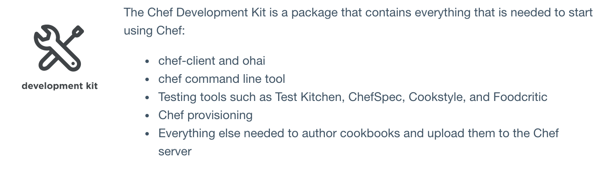
Workstation Components

Slide 7
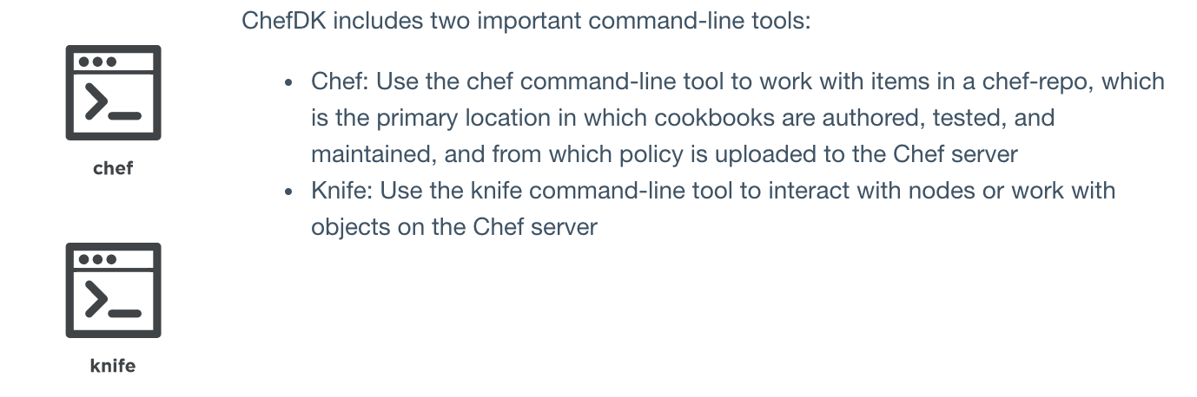
ChefDK: Chef & Knife

Slide 8
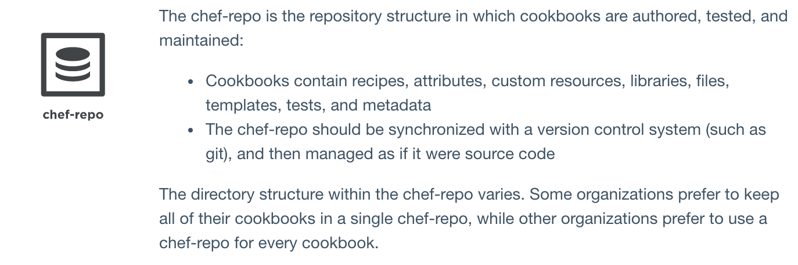
Workstation: Chef-repo

Slide 9
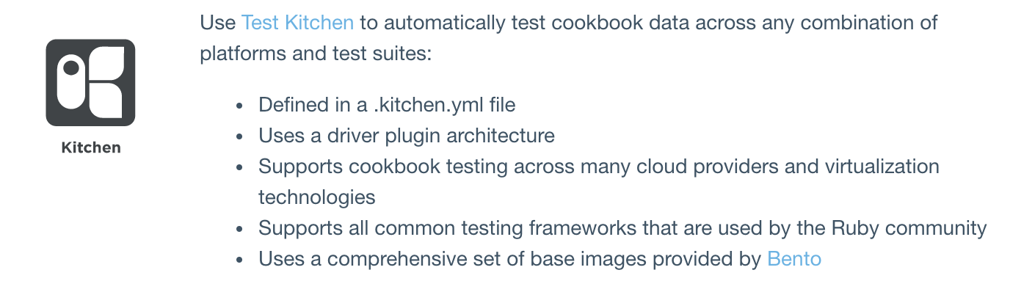
Workstation: Kitchen

Slide 10
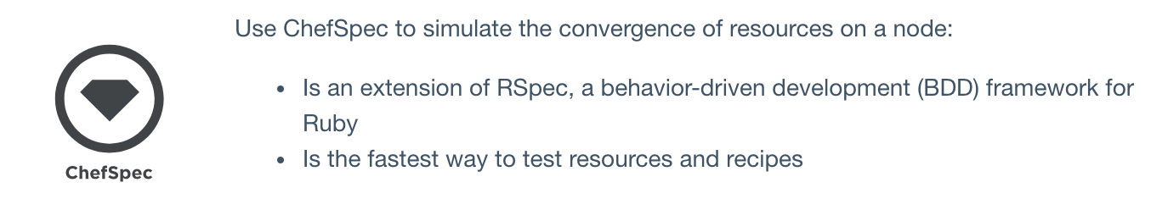
Workstation: Chefspec

Slide 11
Cookbook
A cookbook is the fundamental unit of configuration and policy distribution. A cookbook defines a scenario and contains everything that is required to support that scenario:
Recipes that specify the resources to use and the order in which they are to be applied
Attribute values
File distributions
Templates
Extensions to Chef, such as custom resources and libraries
The chef-client uses Ruby as its reference language for creating cookbooks and defining recipes, with an extended DSL for specific resources. A reasonable set of resources are available to the chef-client, enough to support many of the most common infrastructure automation scenarios; however, this DSL can also be extended when additional resources and capabilities are required.

Slide 12
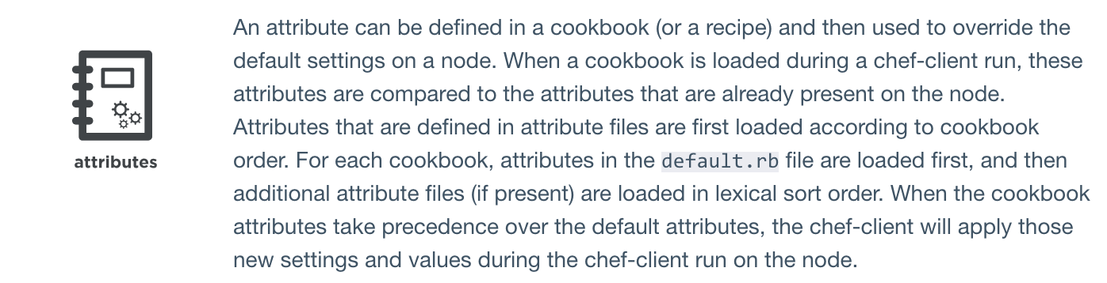
Cookbook: Attributes

Slide 13
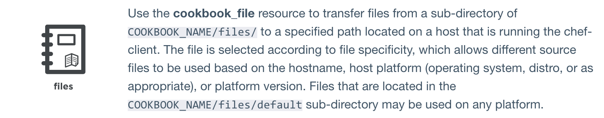
Cookbook: Files

Slide 14
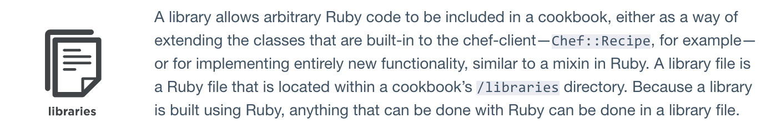
Cookbook: Libraries

Slide 15
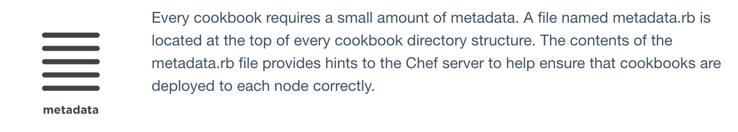
Cookbook: Metadata

Slide 16
Cookbook: Recipes
A recipe is the most fundamental configuration element within the organization. A recipe:
Is authored using Ruby, which is a programming language designed to read and behave in a predictable manner
Is mostly a collection of resources, defined using patterns (resource names, attribute-value pairs, and actions); helper code is added around this using Ruby, when needed
Must define everything that is required to configure part of a system
Must be stored in a cookbook
May be included in a recipe
May use the results of a search query and read the contents of a data bag (including an encrypted data bag)
May have a dependency on one (or more) recipes
May tag a node to facilitate the creation of arbitrary groupings
Must be added to a run-list before it can be used by the chef-client
Is always executed in the same order as listed in a run-list
The chef-client will run a recipe only when asked. When the chef-client runs the same recipe more than once, the results will be the same system state each time. When a recipe is run against a system, but nothing has changed on either the system or in the recipe, the chef-client won’t change anything.

Slide 17
Cookbook: Recipe DSL
The Recipe DSL is a Ruby DSL that is primarily used to declare resources from within a recipe. The Recipe DSL also helps ensure that recipes interact with nodes (and node properties) in the desired manner. Most of the methods in the Recipe DSL are used to find a specific parameter and then tell the chef-client what action(s) to take, based on whether that parameter is present on a node.

Slide 18
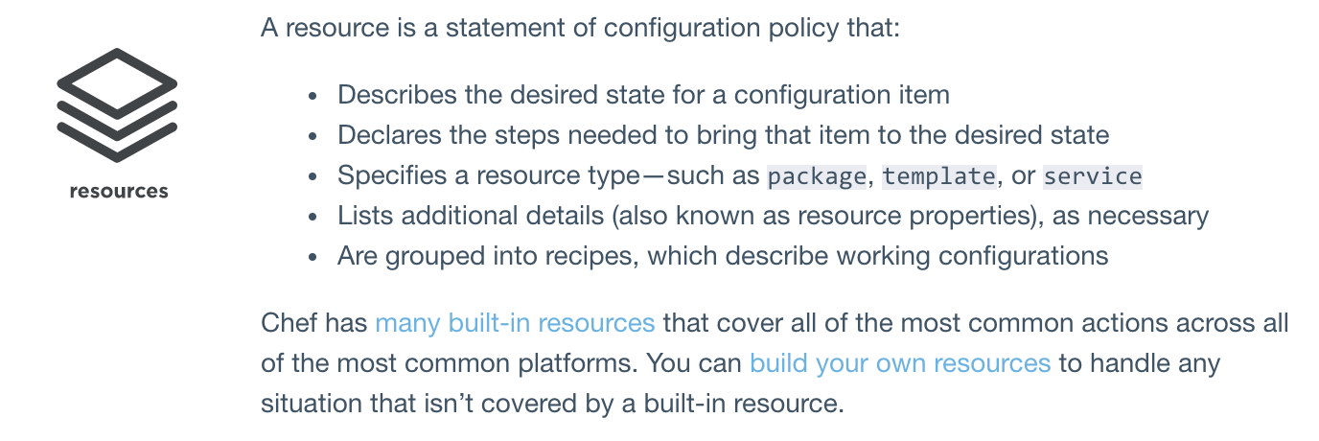
Cookbook: Resouces

Slide 19
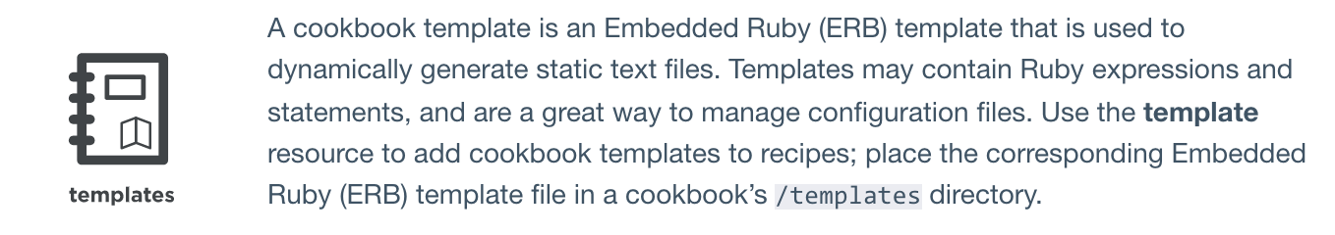
Cookbook: Templates

Slide 20
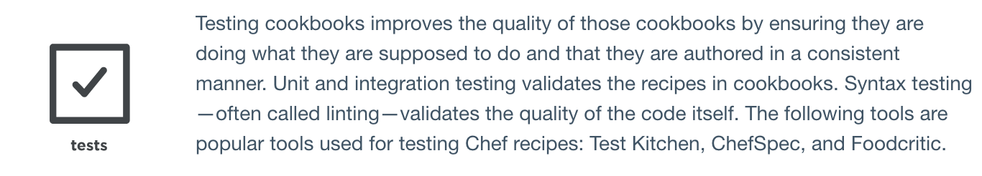
Cookbook: Tests

Slide 21
Nodes
A node is any machine—physical, virtual, cloud, network device, etc.—that is under management by Chef.

Slide 22
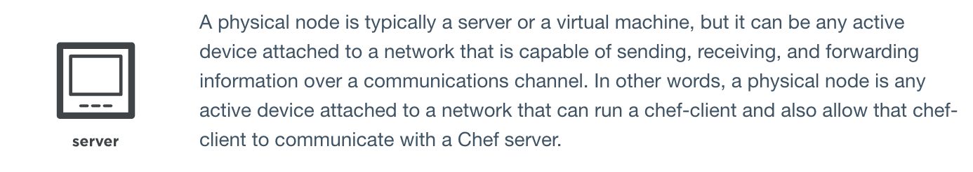
Nodes: Server

Slide 23
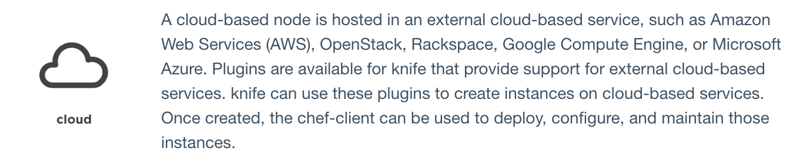
Nodes: Cloud

Slide 24
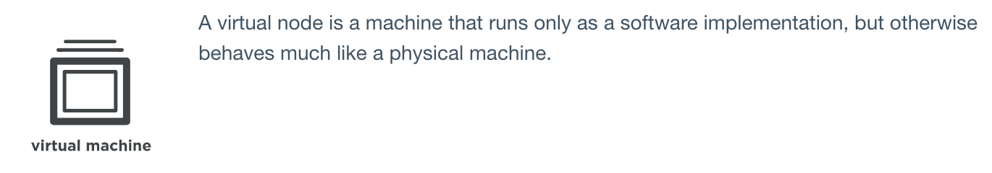
Nodes: Virtual Machine

Slide 25
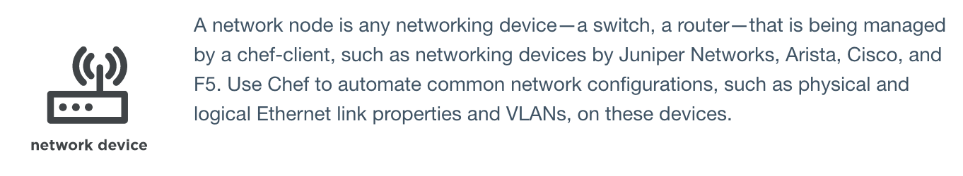
Nodes: Network Device

Slide 26
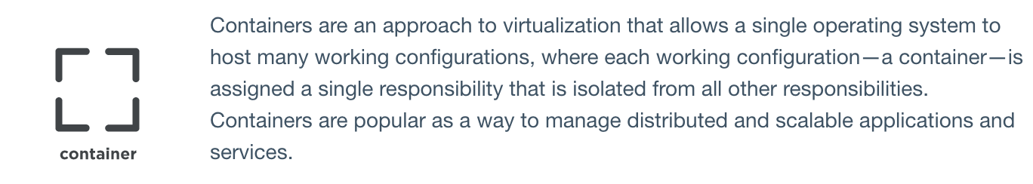
Nodes: Container

Slide 27
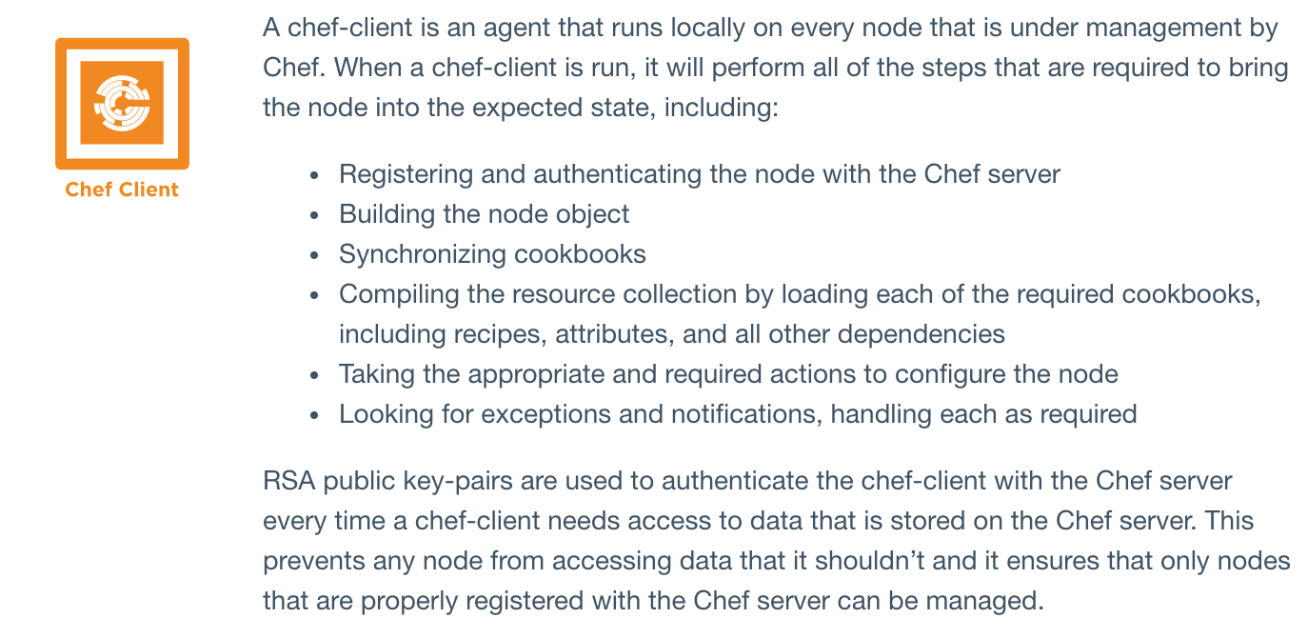
Chef on Nodes: Chef Client

Slide 28
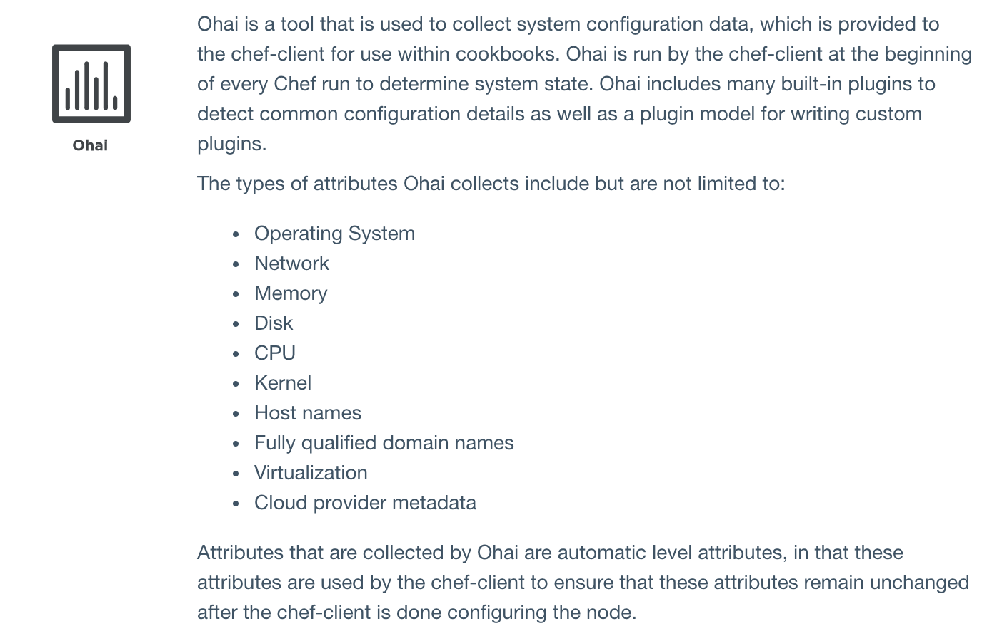
Chef on Nodes: Ohai

Slide 29
Chef Server
The Chef server acts as a hub for configuration data. The Chef server stores cookbooks, the policies that are applied to nodes, and metadata that describes each registered node that is being managed by the chef-client. Nodes use the chef-client to ask the Chef server for configuration details, such as recipes, templates, and file distributions. The chef-client then does as much of the configuration work as possible on the nodes themselves (and not on the Chef server). This scalable approach distributes the configuration effort throughout the organization.

Slide 30
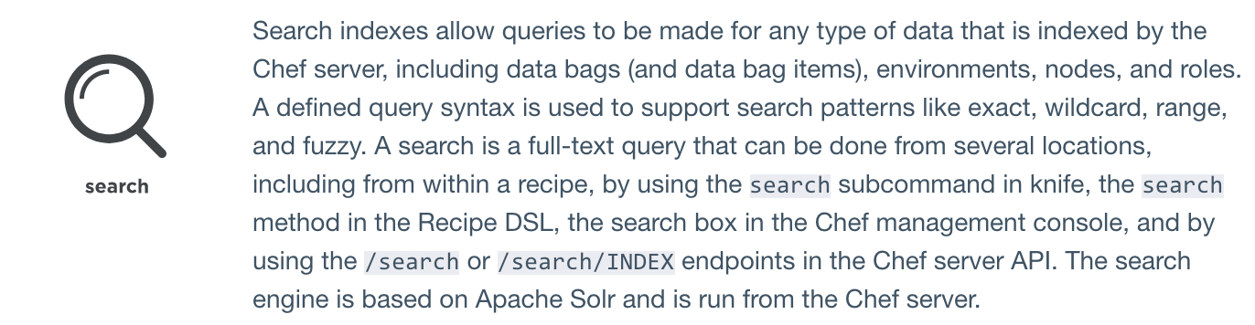
Chef Server: Search

Slide 31
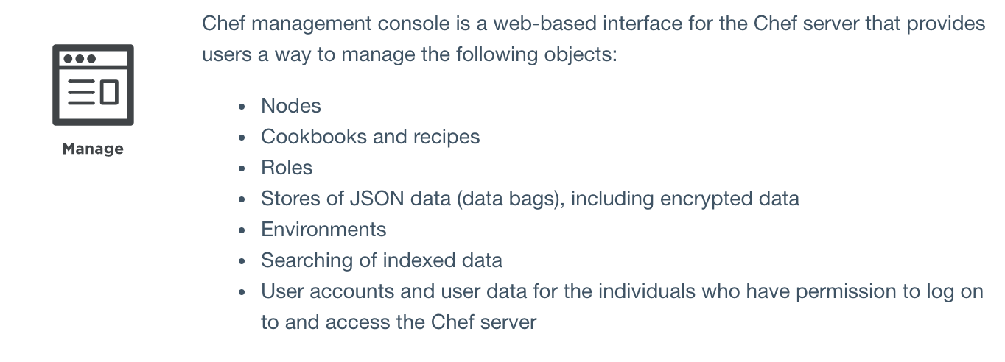
Chef Server: Manage

Slide 32
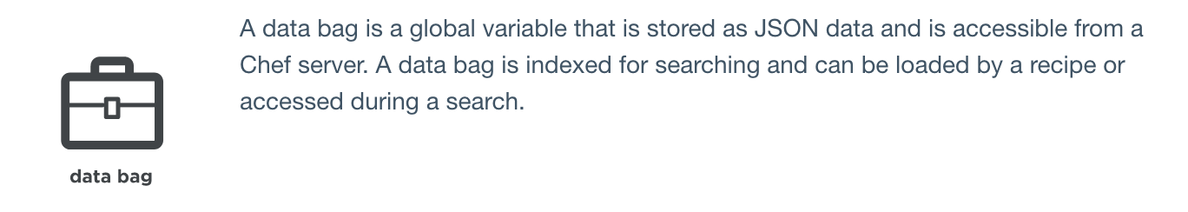
Chef Server: Data bag

Slide 33
Chef Server: Policy
Policy maps business and operational requirements, process, and workflow to settings and objects stored on the Chef server:
Roles define server types, such as “web server” or “database server”
Environments define process, such as “dev”, “staging”, or “production”
Certain types of data—passwords, user account data, and other sensitive items—can be placed in data bags, which are located in a secure sub-area on the Chef server that can only be accessed by nodes that authenticate to the Chef server with the correct SSL certificates
The cookbooks (and cookbook versions) in which organization-specific configuration policies are maintained

Slide 34
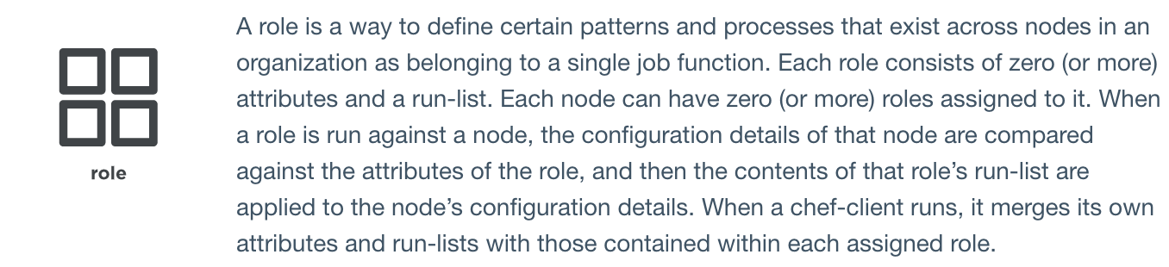
Policy: Role

Slide 35
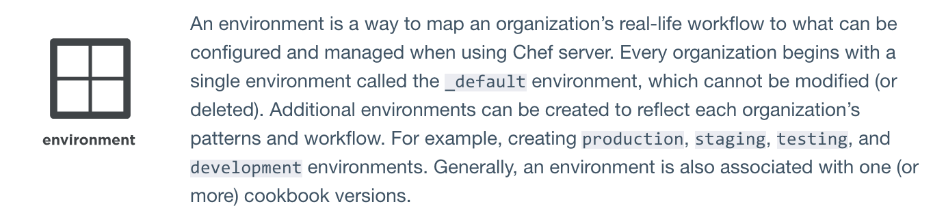
Policy: Environment

Slide 36
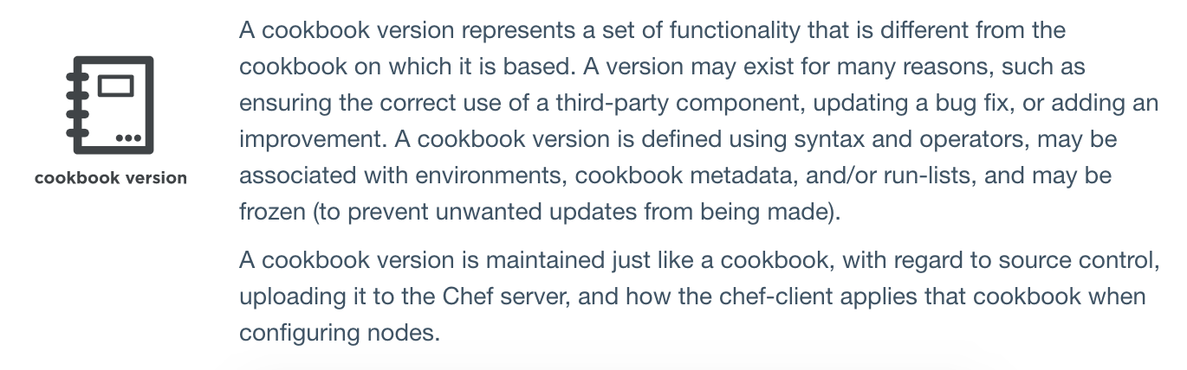
Policy: Cookbook Version

Slide 37
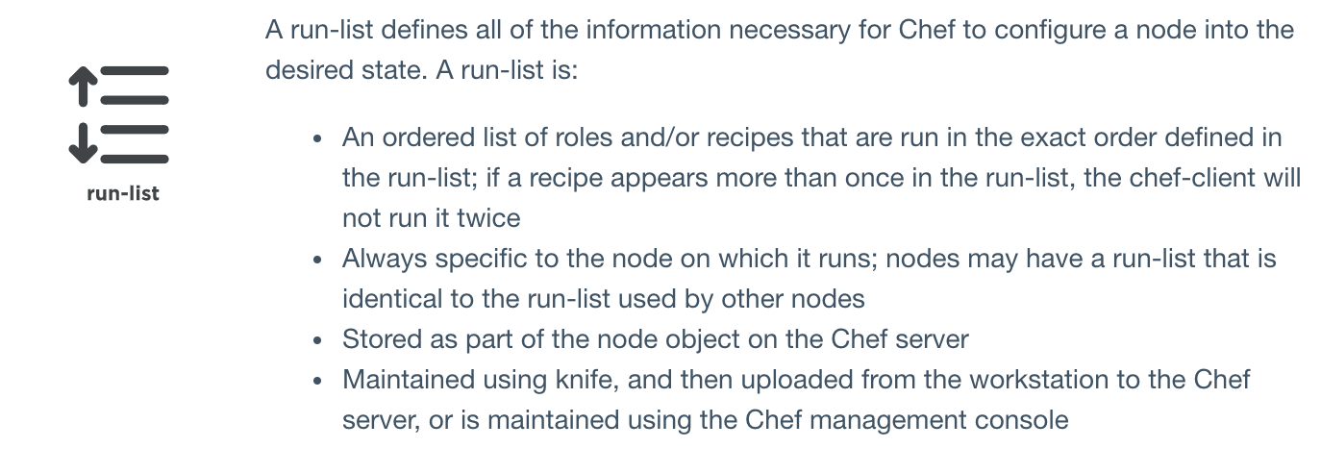
Policy: Run-List

Slide 38
Summary
Chef is a thin DSL (domain-specific language) built on top of Ruby. This approach allows Chef to provide just enough abstraction to make reasoning about your infrastructure easy. Chef includes a built-in taxonomy of all the basic resources one might configure on a system, plus a defined mechanism to extend that taxonomy using the full power of the Ruby language. Ruby was chosen because it provides the flexibility to use both the simple built-in taxonomy, as well as being able to handle any customization path your organization requires.

